Slide 1
FUTURE PERFECT & FUTURE CONTINUOUS

Slide 2
FUTURE PERFECT = WILL + HAVE + (been) + PAST PARTICIPLE
an action that will be FINISHED/COMPLETED BEFORE or BY a definite time in the future
(USUAL) TIME EXPRESSIONS: BY, BY THE TIME, BEFORE, BY THEN
My mum will have cooked lunch before/by the time I arrive home from school.
What will have happed by 2100?
By 2100, a cure for cancer ...........
..............................................will have been discovered.
By 2025,
...............................I will have graduated from college.
In five years, I think...............
.........................................I will have moved to New Zealand.

Slide 3
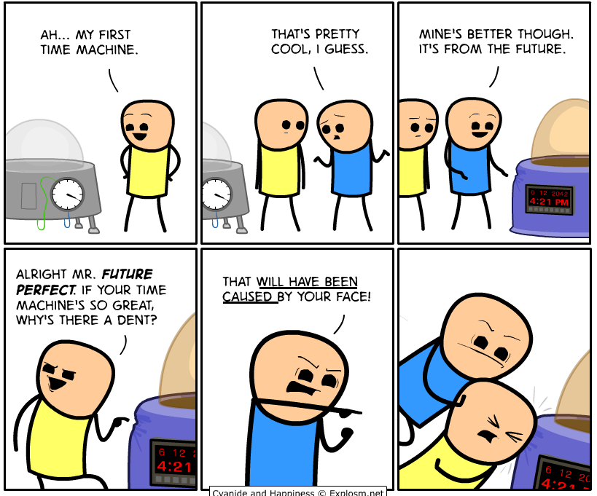

Slide 4
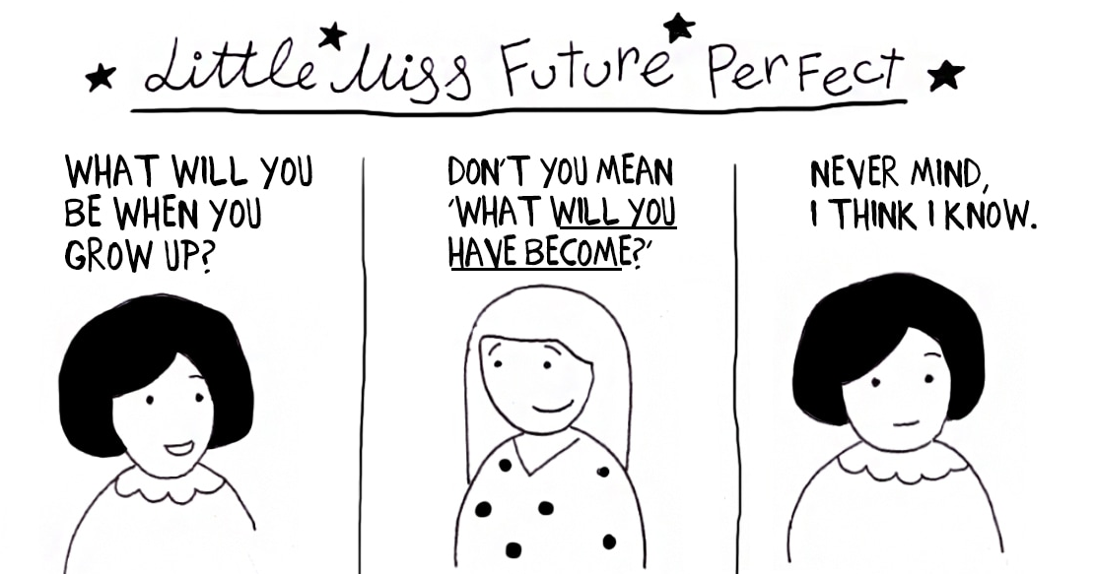

Slide 5
FUTURE CONTINUOUS = WILL BE + ING FORM
an action that will be in progress at a definite time in the future:
(USUAL) TIME EXPRESSIONS: THIS TIME TOMORROW, AT 6 PM, IN THE MORNING...(WHAT WILL YOU BE DOING?)
This time tomorrow I will be lying on the beach.
We will be discussing your exam results this time next week.
Now you are sitting in your classroom. This time on Sunday you will be sleeping in your beds and you will be dreaming about your future. You won’t be thinking about English future tenses.

